Slide 1

Memory Technologies Spring 2024
Hamed Farbeh
farbeh@aut.ac.ir
Department of Computer Engineering
Amirkabir University of Technology

Slide 2
Reference
Memory Systems: Cache, DRAM, Disk, Bruce Jacob, Spencer W. Ng, and David T. Wang, Morgan Kaufmann, 2008

Slide 3
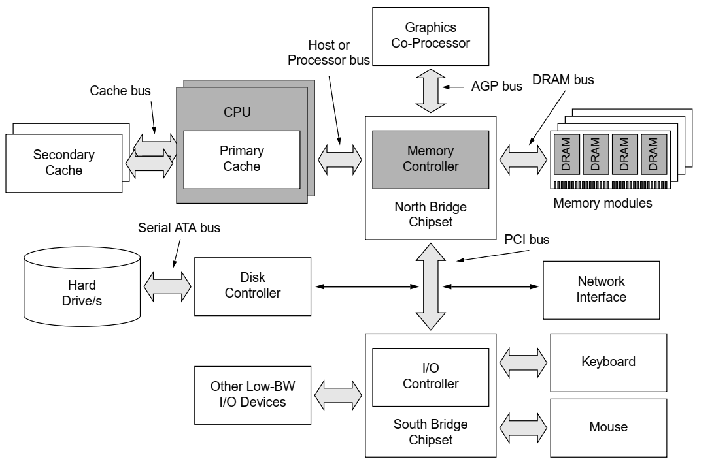
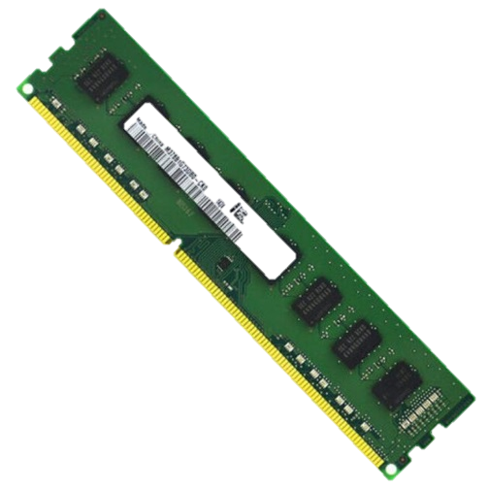
Overview of DRAMs

Slide 4
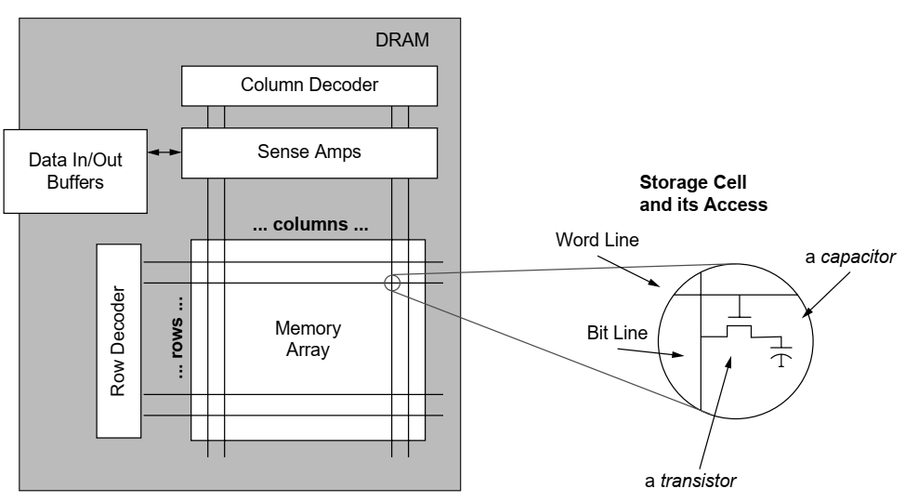
DRAM Internals
DRAM memory array

Slide 5
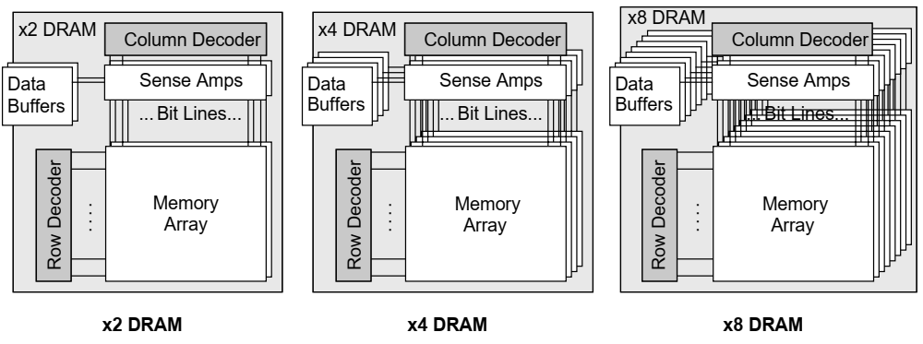
DRAM Internals
DRAM memory chip
Each set of memory arrays that operates independently of other sets is referred to as a bank, not an array.

Slide 6
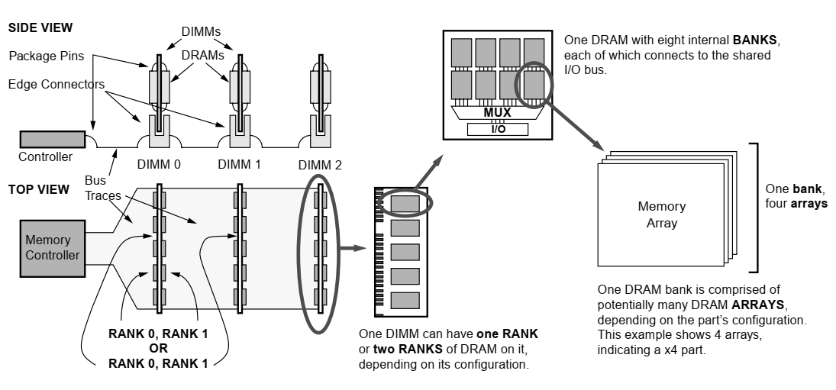
DRAM Internals
DIMM, rank, bank

Slide 7
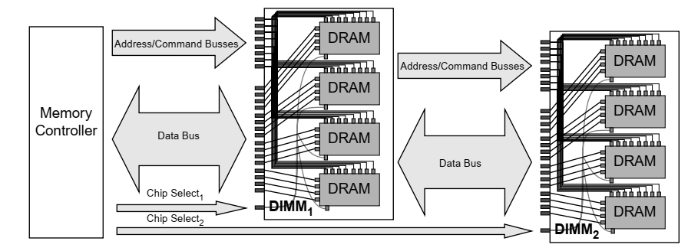
Memory Bus Organization

Slide 8
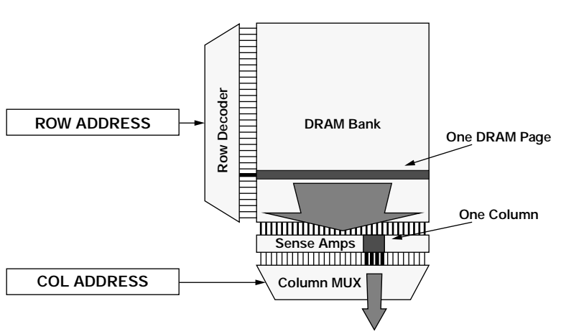
Memory Bus Organization
DRAM Access

Slide 9
Evolution of the DRAM Architecture
Fast Page Mode (FPM)
Allows the row to remain open across multiple CAS commands
Eliminates the need for a row address if data is located in the row previously accessed
Speeds up successive accesses to the same row of the DRAM core
Extended data out (EDO)
Also referred to as Hyper Page Mode enabled DRAM
Adds a few transistors to the output drivers of an FPM DRAM to create a latch between the sense amps and the output pins of the DRAM
A new access cycle could be started while the data output from the previous cycle was still present
It held the output valid until either
RAS was dis-asserted, or
a new CAS falling edge selected a different column address

Slide 10
Evolution of the DRAM Architecture
Burst EDO DRAM
Could process four memory addresses in one burst
By adding an address counter on the chip to keep track of the next address
Never reached the volume of production that EDO and SDRAM did
Synchronous DRAM
Adding a clock (and a clock enable) line
All other signals are received on the rising edge of the clock
The /RAS and /CAS inputs no longer act as strobes
But are instead, along with /WE, part of a 3-bit command

Slide 11
Evolution of the DRAM Architecture
Synchronous DRAM
/CS | /RAS | /CAS | /WE | Address | Command
H | x | x | x | x | Command inhibit (No operation)
L | H | H | H | x | No operation
L | H | H | L | x | Burst Terminate: stop a read or write burst in progress
L | H | L | H | column | Read from currently active row
L | H | L | L | column | Write to currently active row
L | L | H | H | row | Activate a row for read and write
L | L | H | L | x | Precharge (deactivate) the current row
L | L | L | H | x | Auto refresh: Refresh one row of each bank, using an internal counter
L | L | L | L | mode | Load mode register: Address bus specifies DRAM operation mode.

Slide 12
Evolution of the DRAM Architecture
Double Data Rate DRAM (DDR SDRAM)
Doubles the data bandwidth available from single data rate SDRAM
By transferring data at both edges of the clock

Slide 13
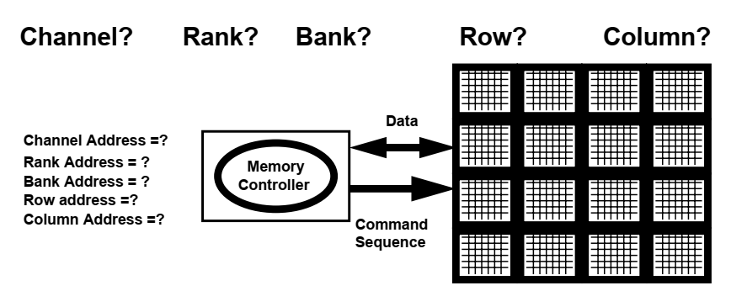
DRAM Memory System Organization

Slide 14
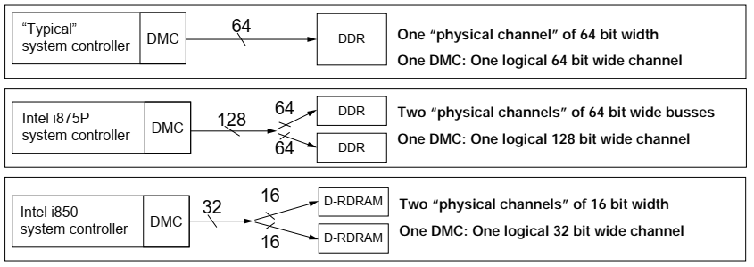
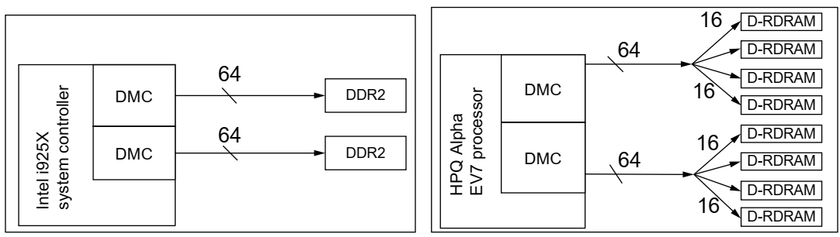
DRAM Memory System Organization
Channel

Slide 15
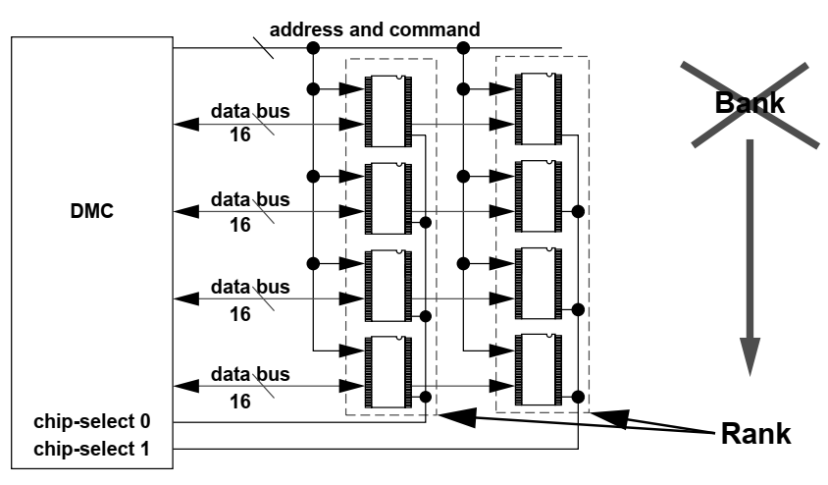
DRAM Memory System Organization
Rank

Slide 16
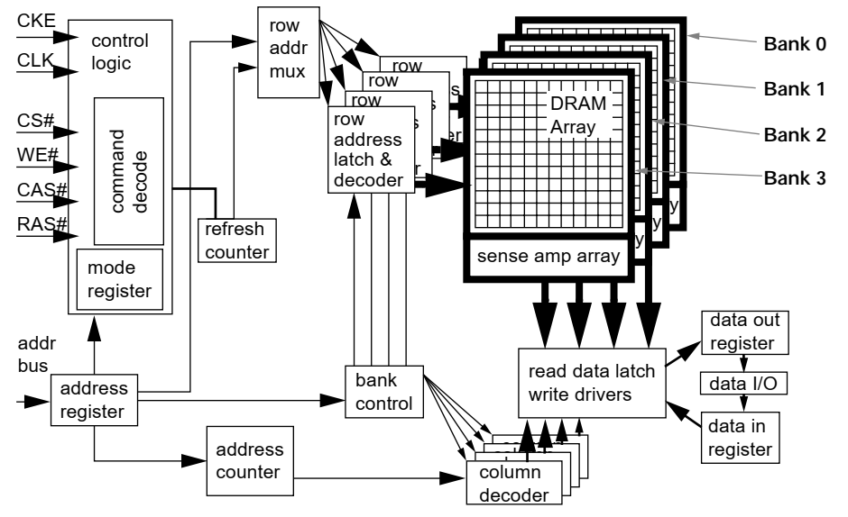
DRAM Memory System Organization
Bank

Slide 17
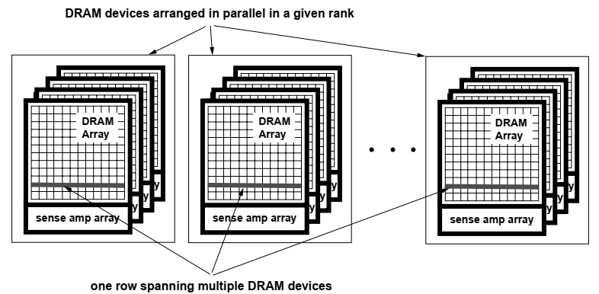
DRAM Memory System Organization
Row

Slide 18
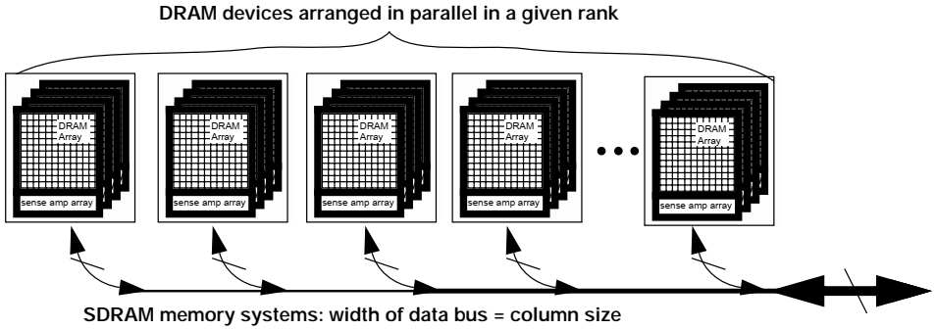
DRAM Memory System Organization
column

Slide 19
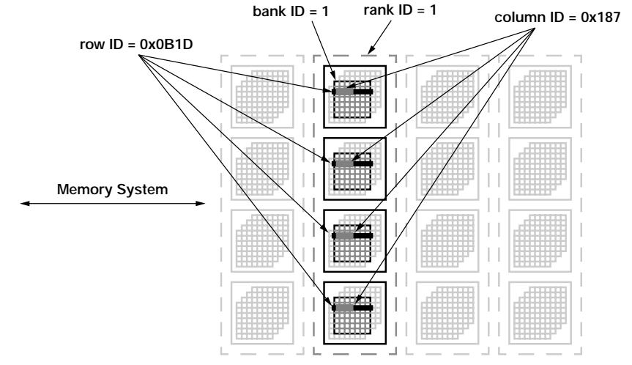
DRAM Memory System Organization
An Example

Slide 20
Memory Modules
Single In-line Memory Module (SIMM)
Contacts on either side of the bottom of the module are identical
30-pin SIMMs
Late 1980s and early 1990s
8 or 9 signals for data bus+ cmds, addr, power, CS, …
72-pin SIMMS
32 to 64 bits data bus
Dual In-line Memory Module (DIMM)
Contacts on either side of a DIMM are electrically different
Late 1990s
Physically larger than SIMMs
64- or 72-bit-wide data bus interface
Also referred to as Unbuffered DIMMs (UDIMMs)

Slide 21
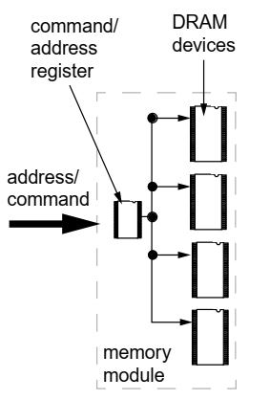
Memory Modules
Registered Dual In-line Memory Modules (RDIMMs)
Alleviate the issue of electrical loading of large numbers of DRAM devices in a large memory system
Use of registers that buffer the address and control signals at the interface of the memory module
Registers greatly reduce the number of electrical loads that a memory controller must drive directly
Buffering of the address and control signals introduces delays into the memory-access latency

Slide 22
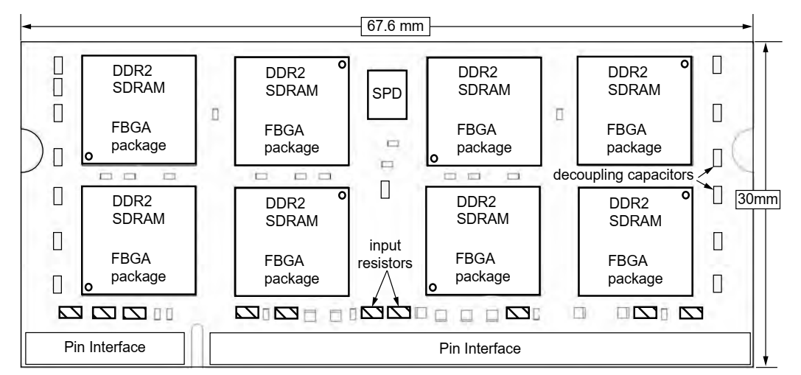
Memory Modules
Small Outline DIMM (SO-DIMM)
Designed to fi t into the limited space found in mobile notebook computers

Slide 23
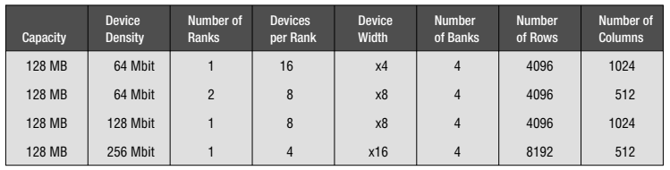
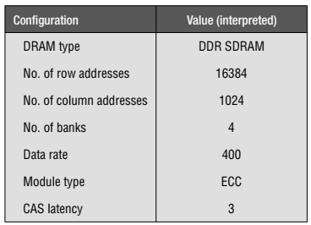
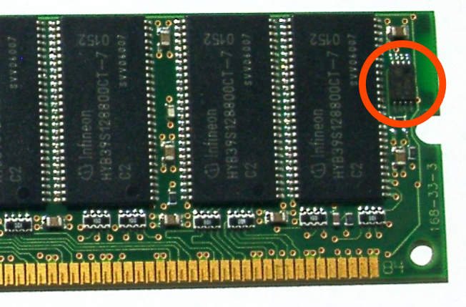
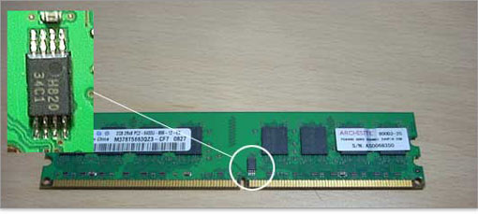
Memory Modules
Different memory-module organizations
Serial presence detect (SPD)

Slide 24
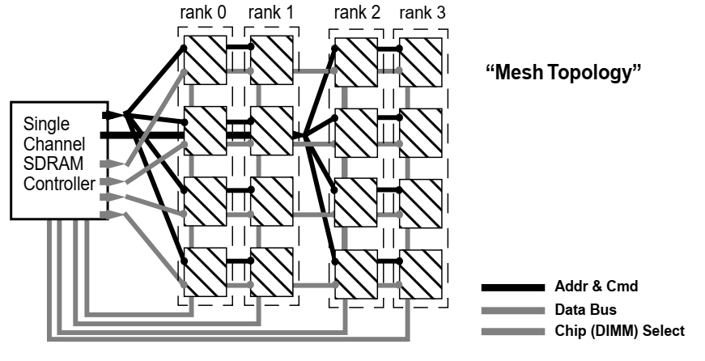
Memory System Topology
Determines the signal path lengths and electrical loading characteristics in the memory system

Slide 25
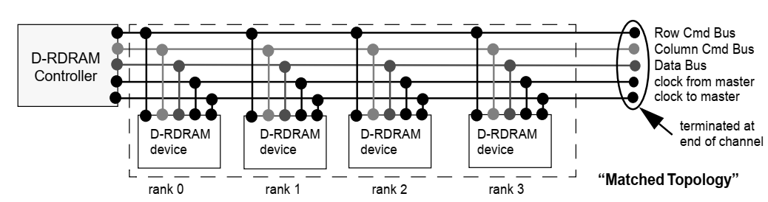
Memory System Topology
Direct RDRAM System Topology

